Slide 2
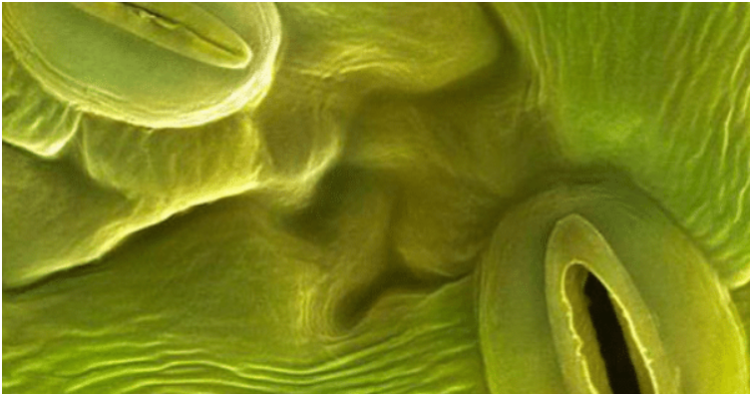
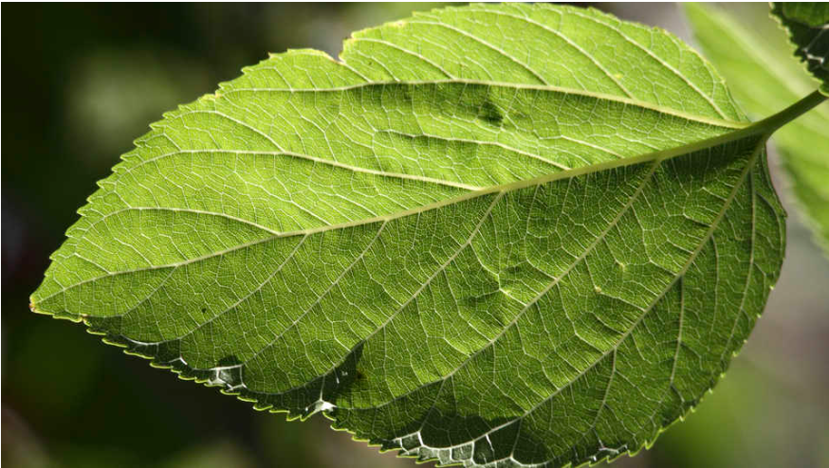
Stomata
Definition
Stomata are tiny openings or pores in plant tissue that allow for gas exchange (CO2, H2O…).

Slide 3
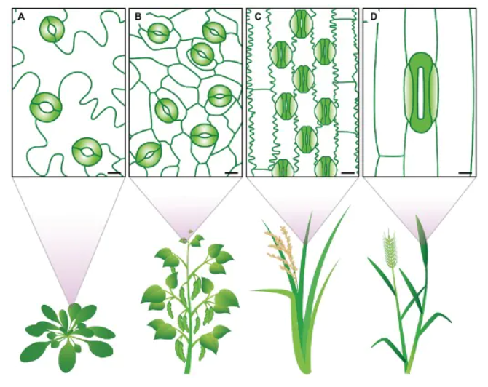
Stomatal traits vary between species
The eudicots (A) Arabidopsis thaliana; (B) Phaseolus vulgaris; (C) Oryza sativa; (D) Triticum aestivum
dumbbell-shaped guard cells (solid green) and specialized subsidiary cells (light green gradient).
Clear differences in stomatal size and stomatal density can be observed [1]
[1]: Bertolino L T, Caine R S, Gray J E. Impact of stomatal density and morphology on water-use efficiency in a changing world[J]. Frontiers in plant science, 2019, 10: 225.

Slide 4
Functions [1]
Exchange the gases by closing and opening the pores in the leaves.
Removes oxygen and takes in carbon dioxide at the time of photosynthesis.
Assists in eradicating excess water from the leaves. (water exchange)
Assists in monitoring the movement of water via transpiration.
Play a significant role in photosynthesis and transpiration [2-3]
[1]: Melotto M, etc. Role of stomata in plant innate immunity and foliar bacterial diseases.
Annu Rev Phytopathol.
[2]: Lawson T, etc, photosynthesis and plant water use efficiency[J]. New Phytologist, 2019.
[3]: Tuzet, A.J. Stomatal Conductance, Photosynthesis, and Transpiration, Modeling. Encyclopedia of Agrophysics.
Encyclopedia of Earth Sciences Series. Springer,

Slide 5
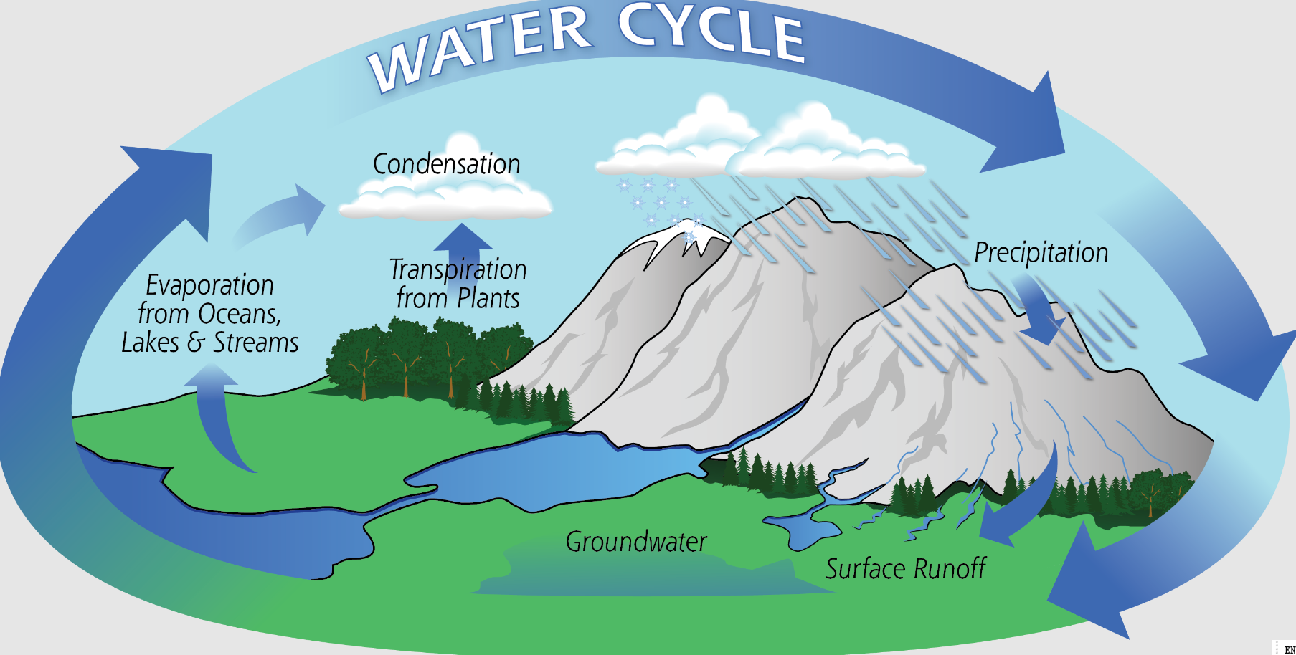
Driving the water cycle, refer to [1]
[1]: Hetherington A M, etc. The role of stomata in sensing and driving environmental change[J].
Nature, 2003, 424(6951): 901-908.

Slide 6
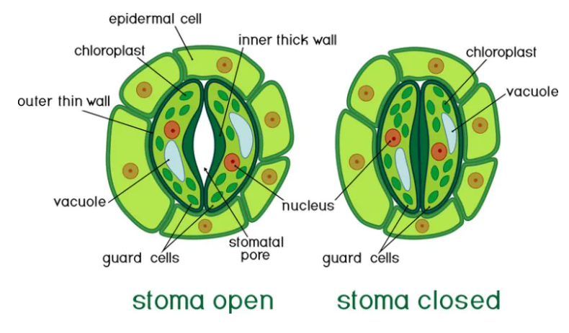
Stomata conductance
Stomata dynamics---open and close
Stomata are constituted by two cells : Guard cells.
Guard cells are hydraulic valves making possible stomata closure and opening.

Slide 7
Stomata conductance
Definition
Stomatal conductance (gs) is the diffusion of gas, such as carbon dioxide, water vapor, and oxygen, through the stomata of a plant.
Importance of measuring
Estimates the rate of gas exchange (i.e., carbon dioxide uptake) and transpiration (i.e., water loss) through the leaf stomata as determined by the degree of stomatal aperture (and therefore the physical resistances to the movement of gases between the air and the interior of the leaf).[1]
[1]: Cotthem, Willem Van (2018-01-30). "Stomatal conductance". PLANT STOMATA ENCYCLOPEDIA

Slide 8
Stomata conductance
Influences
Internal Influences: plant-level factors
Signals from the guard cell and stomatal density
Changes in leaf water potential
Need to take in CO2 for photosynthesis
Etc.
External Influences: Environmental factors
Light is the primary external factor that determines stomatal conductance, as stomata are activated and open during daylight.
Air temperature rises will increase stomatal conductance, independent of plant water status and photosynthesis.
Elevated atmospheric CO2 concentration decreases stomatal conductance, which can end up reducing photosynthesis.
Humidity influences stomatal conductance. Low humidity reduces stomatal conductance to preserve water. Stomata will open in high humidity even if the leaf water content is less.
Etc.

Slide 9
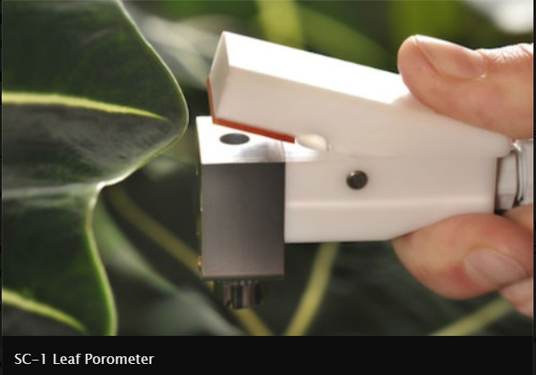
Stomata conductance measure method
Steady-state porometers: A steady state porometer measures stomatal conductance using a sensor head with a fixed diffusion path to the leaf. It measures the vapor concentration at two different locations in the diffusion path. (e.g., Decagon: SC-1)

Slide 10
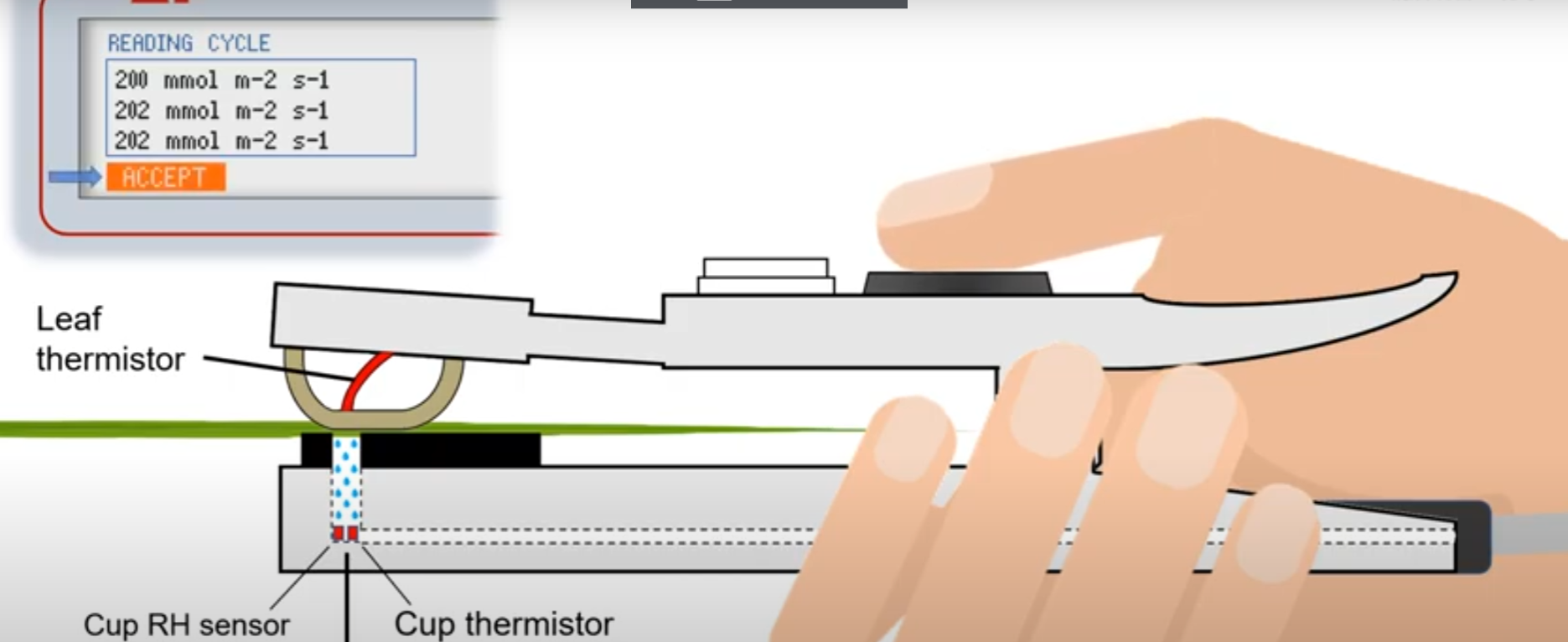
Stomata conductance measure method
Dynamic Diffusion– measures the rate of RH increase in a chamber clamped to the leaf surface. (e.g., Delta-T Device: AP4)

Slide 11
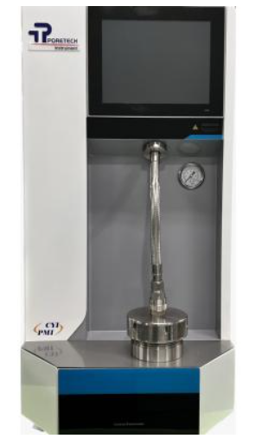
Stomata conductance measure method
Viscous or Mass Flow– measures the time (in 1/100th of a second) to force a fixed volume of pressurized air through the leaf. (e.g., Thermoline)

Slide 12
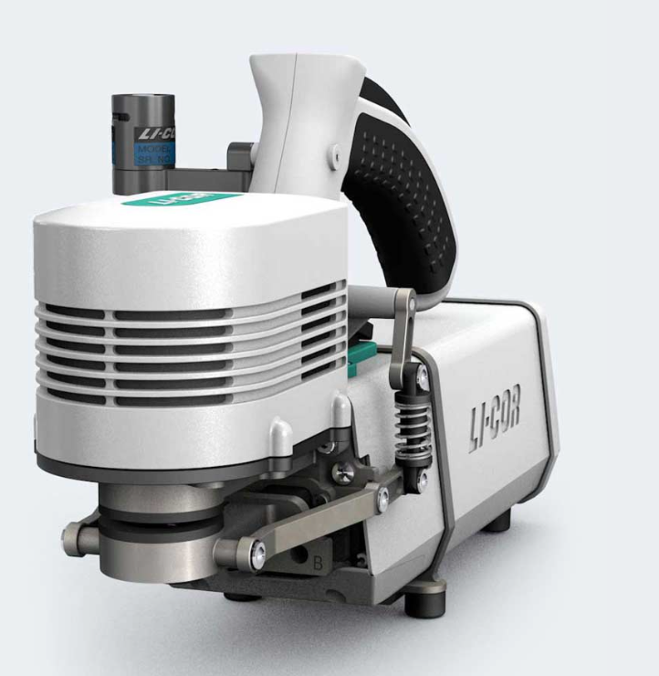
Stomata conductance measure method.
Null Balance – measures the vapor fl ux and vapor gradient near the leaf surface by calculati ng the fl ow rate needed to keep stable RH inside the chamber (including air and leaf temperature). (e.g., LICOR: LI-1600)

Slide 13
Modeling the stomata dynamic process
Our purpose: Measure the dynamic activities of stomata opening process
What we need to measure?
relative humidity
Light intensity
Keep other conditions unchanged

Slide 14
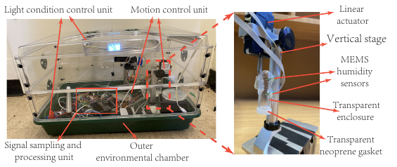
Measurement instrument
Basic structures

Slide 15
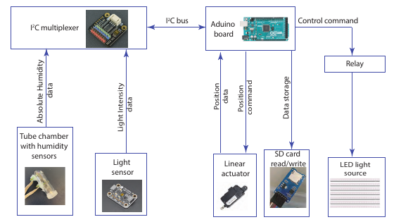
Structure

Slide 16
Measurement instrument
Basic structures

Slide 17
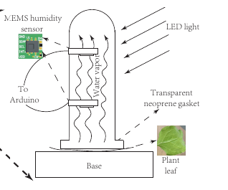
Measurement instrument
Measurement procedure
Dark preprocessing (around 12 mins)
Press the chamber on leaf surface
Turn off the light (1 hour)
Turn on the light and lift the chamber

Slide 18
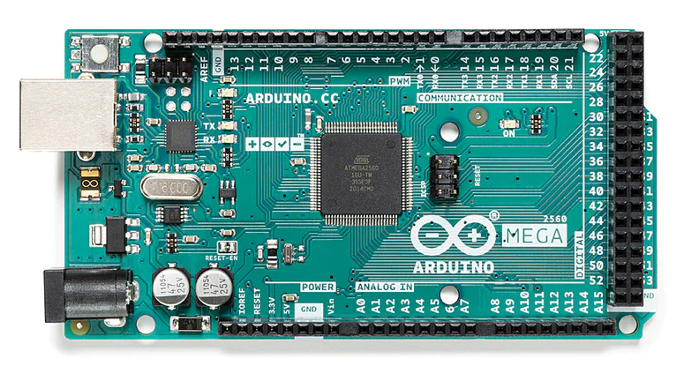
Technique details
Arduino board
We use Mega 2560
Getting start: https://docs.arduino.cc/software/ide-v1/tutorials/getting-started/cores/arduino-avr

Slide 19
Technique details
Pinout & data sheet: https://docs.arduino.cc/hardware/mega-2560
Tutorials docs: https://docs.arduino.cc/tutorials/
Tutorials from Paul McWhorter (Video): https://www.youtube.com/@paulmcwhorter

Slide 20
Technique details
Sensors
Humidity sensor -TI HDC-2080
User guide https://www.ti.com/product/HDC2080?utm_source=google&utm_medium=cpc&utm_campaign=asc-null-null-gpn_en-cpc-pf-google-tw&utm_content=hdc2080&ds_k=&dcm=yes
HDC2080EVM module : https://www.ti.com/tool/HDC2080EVM (includes user guide, applications, etc.)

Slide 21
Technique details
Sensors
Light sensor --- TSL2591
Docs & code: https://learn.adafruit.com/adafruit-tsl2591/overview
Servo actuator --- PA-12-10645012R
Docs : https://www.progressiveautomations.com/products/micro-servo-actuator-rs485

Slide 24
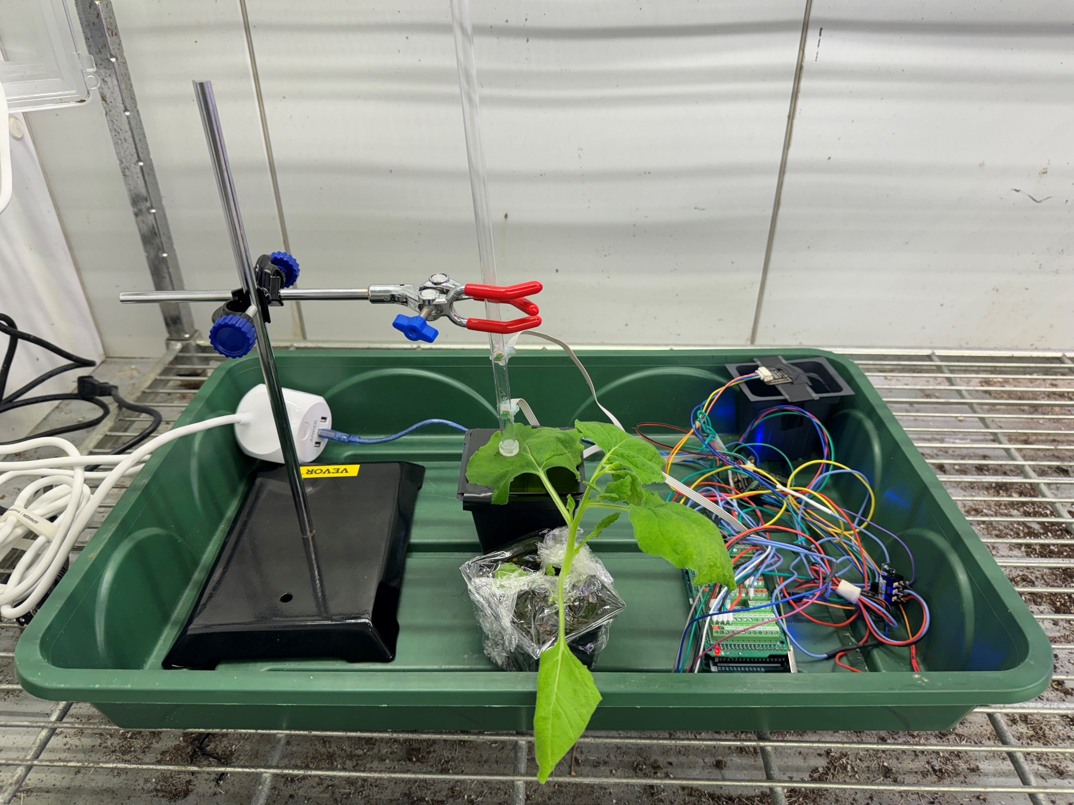
Tube
Stage
Arduino
Tobacco

Slide 25
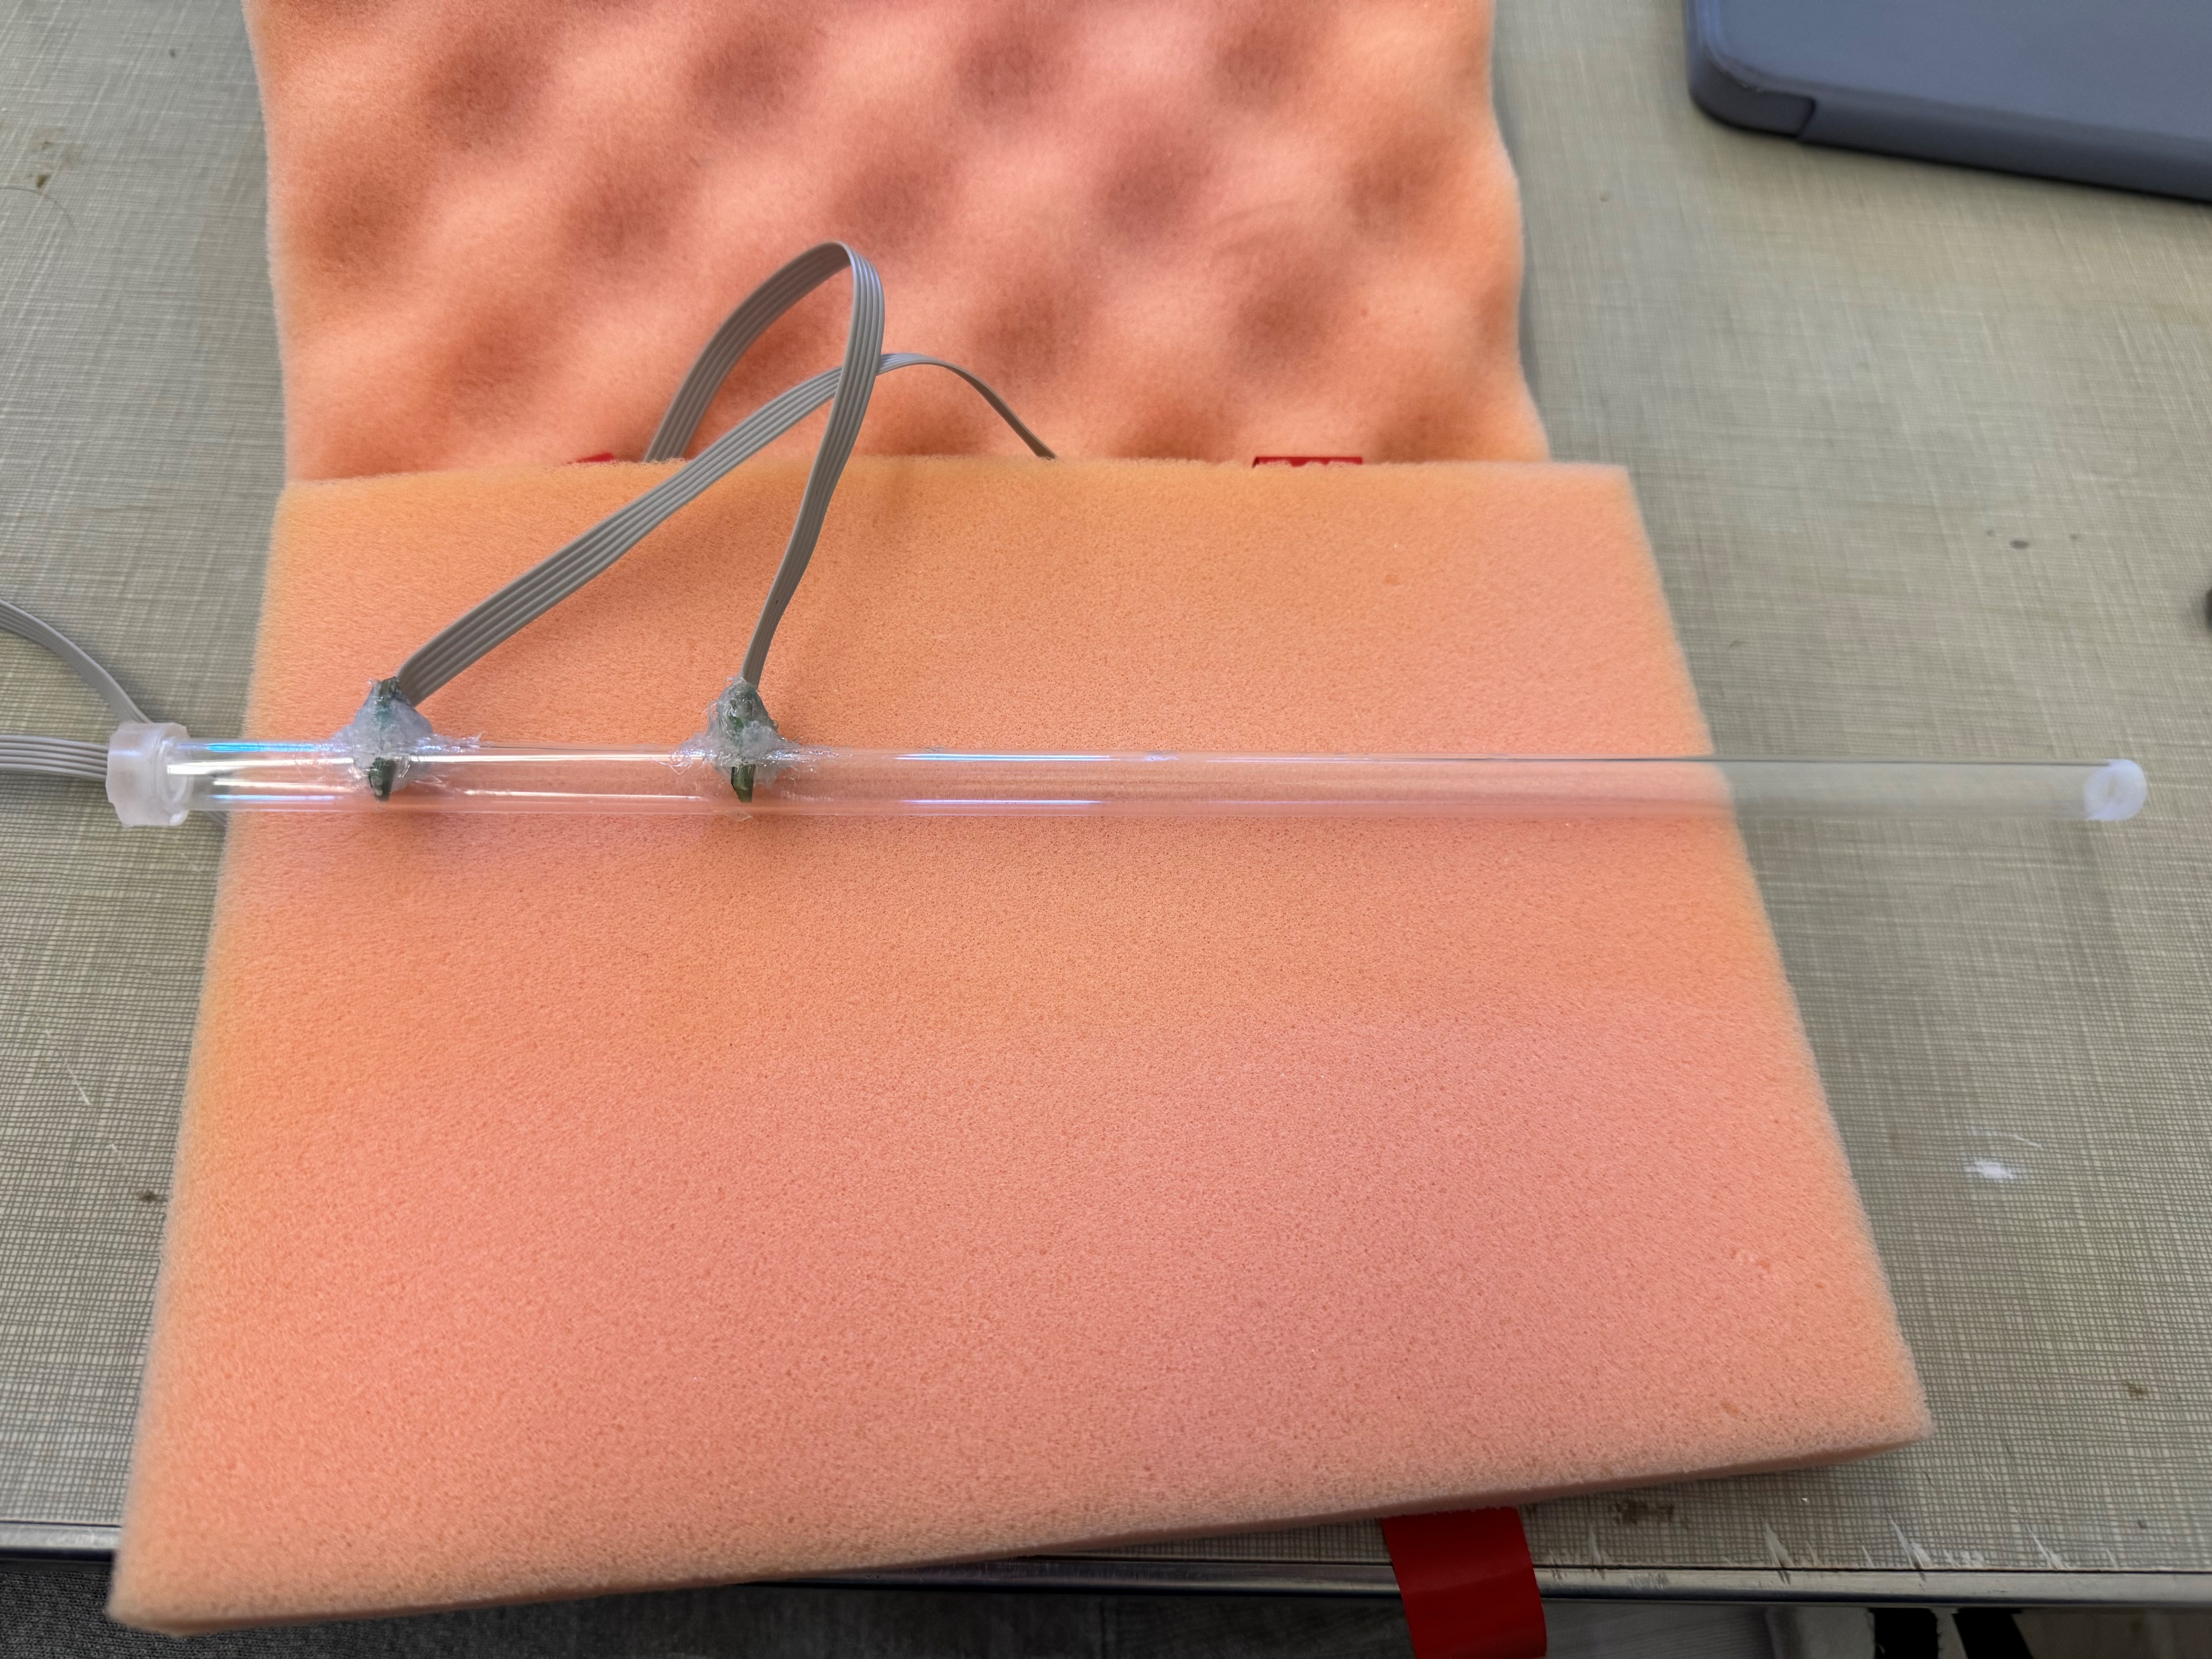
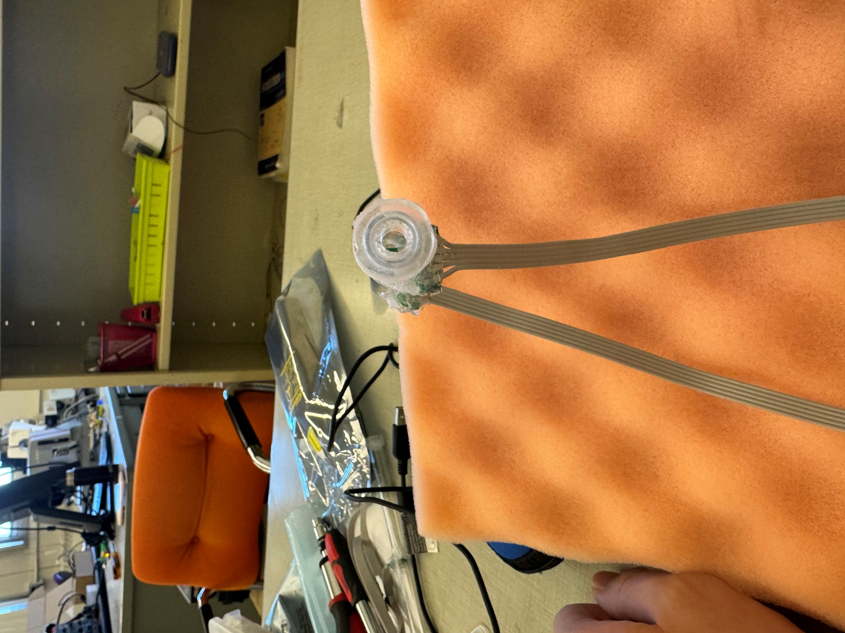
d = 52 mm
D = 5mm
L = 300 mm

Slide 26

Integrated development environment
Attention!
At least one PC with windows!

Slide 27
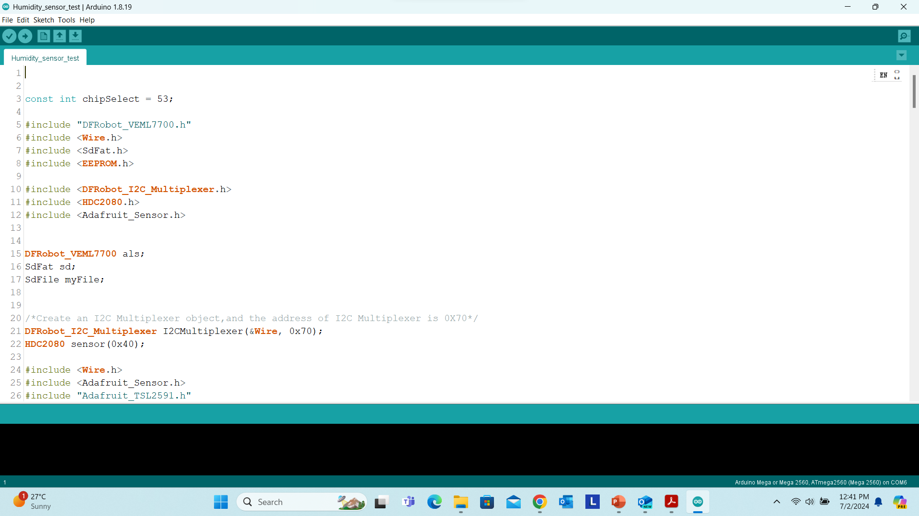

Slide 28
5 sensors: I2C multiplexer, humidity sensor, Light sensor, SD card read/write block, Solid moisture sensor

Slide 29
Procedure of development in Arduino IDE
Look up the type of the sensor
Take a look at the technique document
Install the corresponding library in IDE
Find the example code
Write your own code

Slide 30
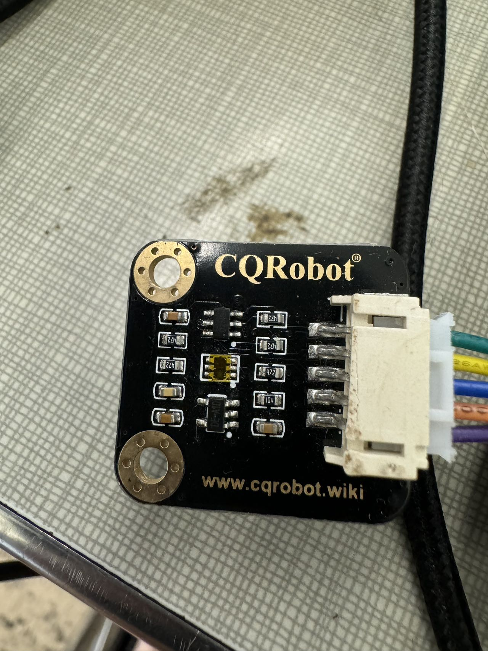
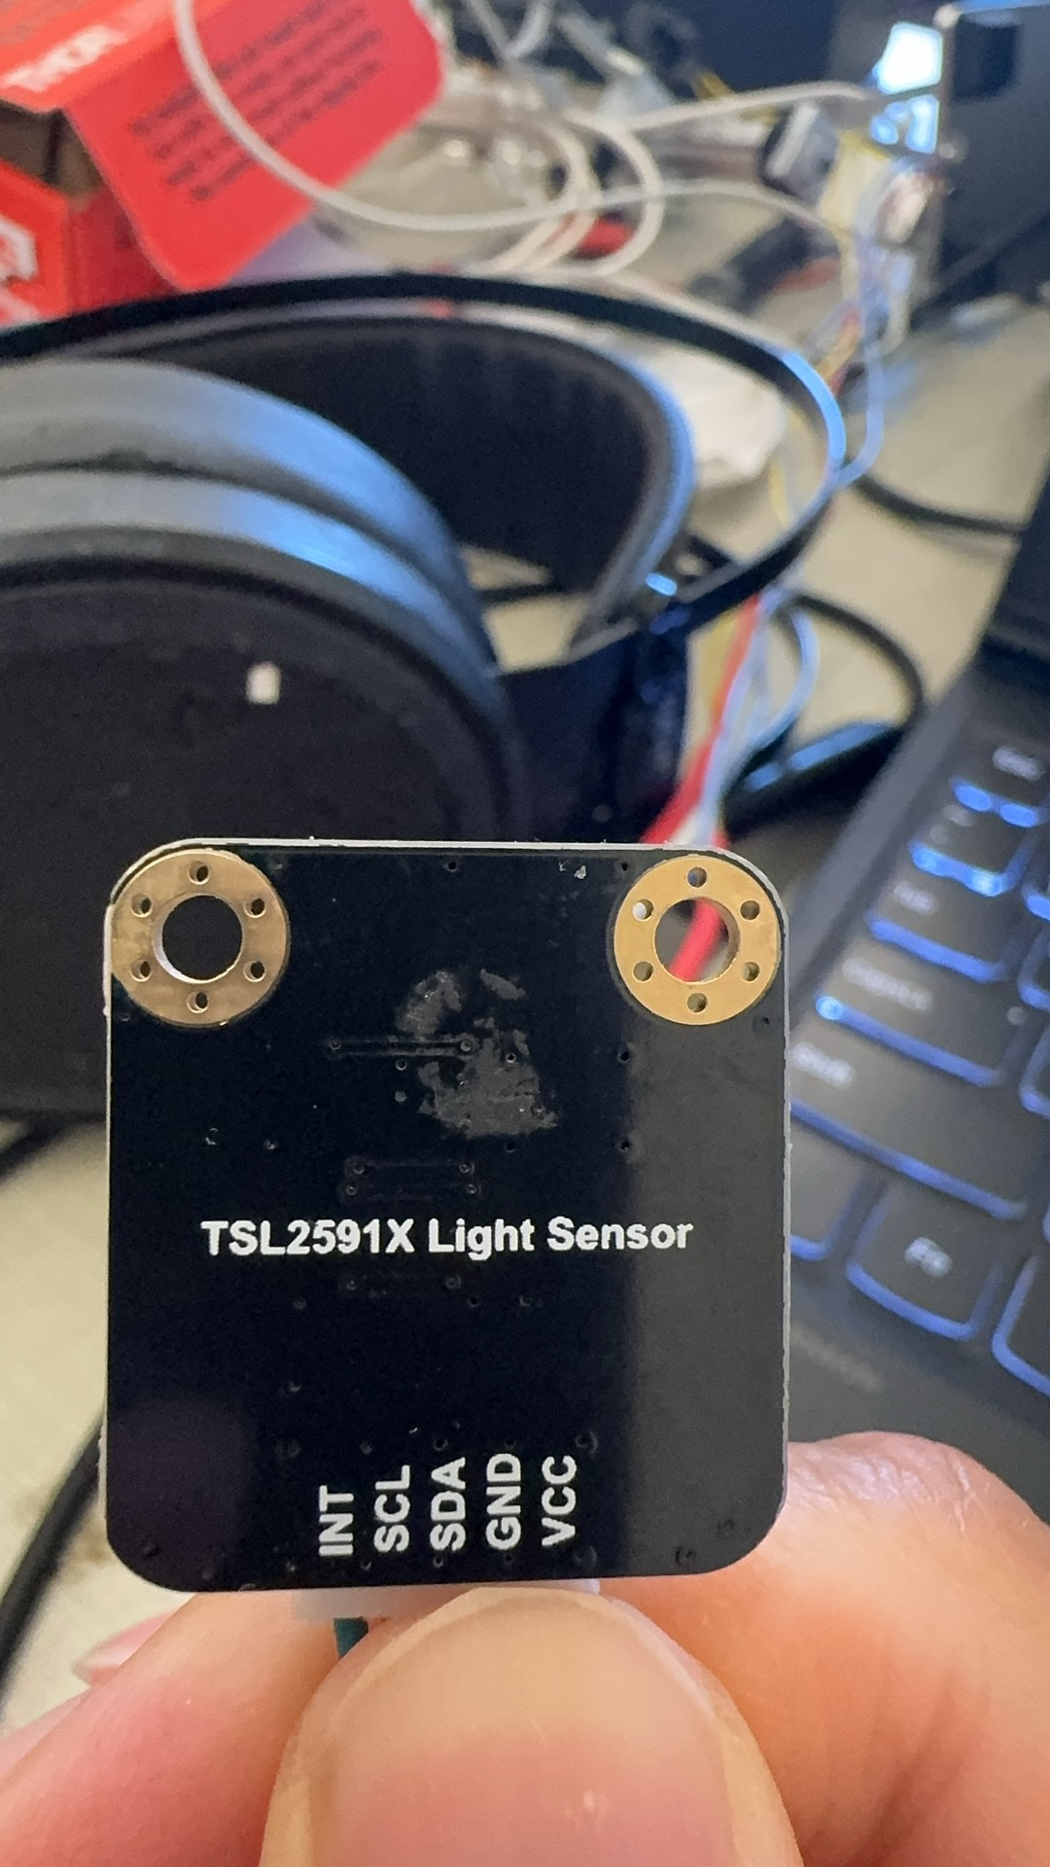
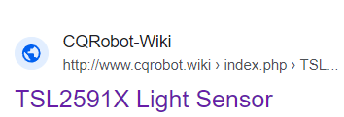
Procedure of development in Arduino IDE
Look up the type of the sensor ( Take a look at the sensor)

Slide 31
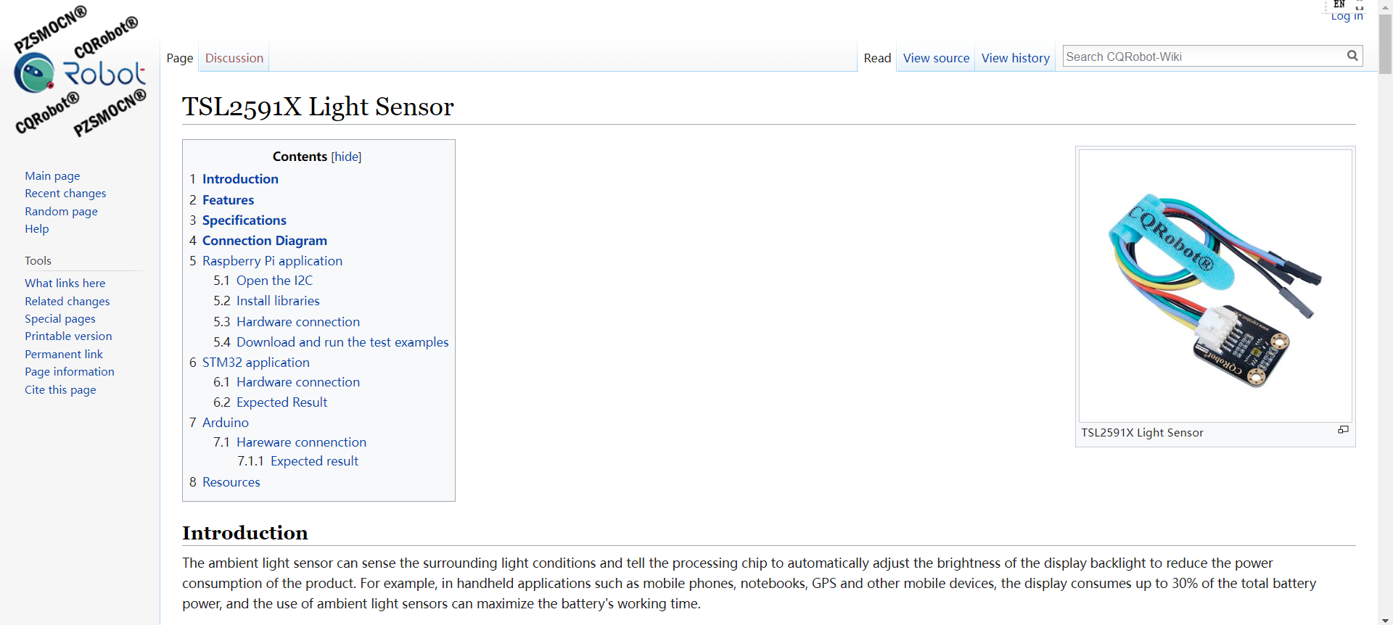
Take a look at the technique document

Slide 32
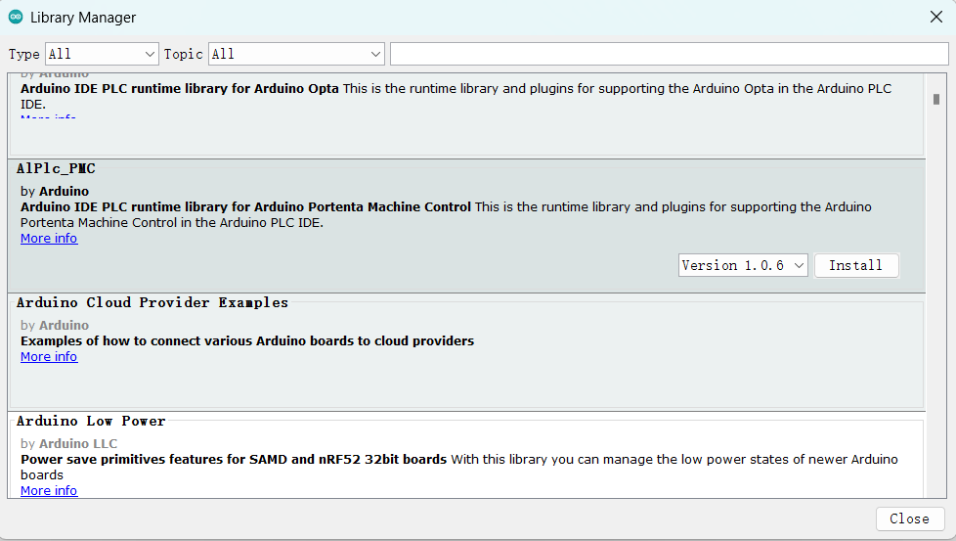
Install the corresponding library in IDE
Tools->Manage libraries

Slide 33
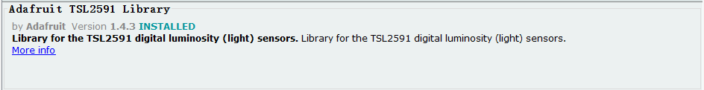
Search ‘Light sensor’

Slide 34
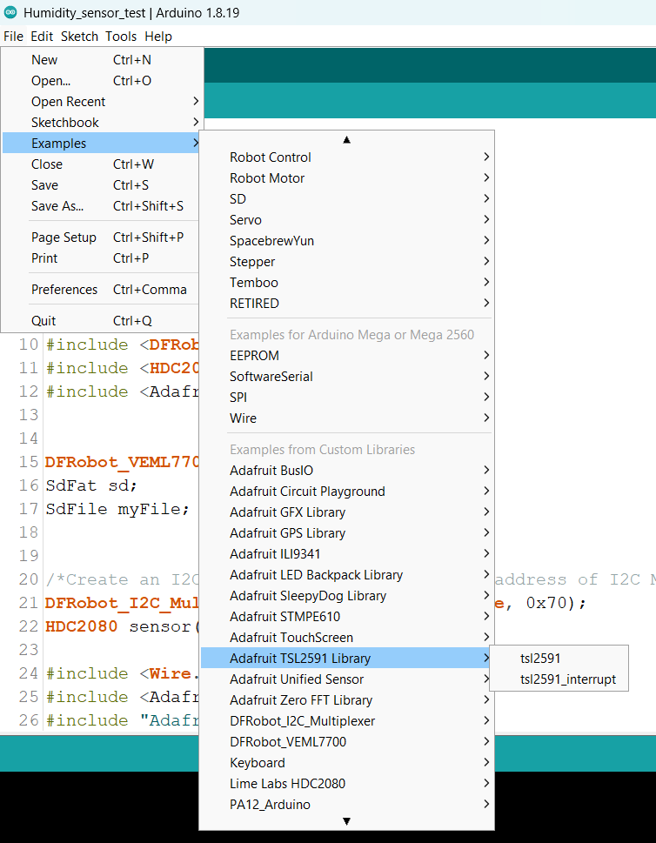
Find the example code

Slide 35
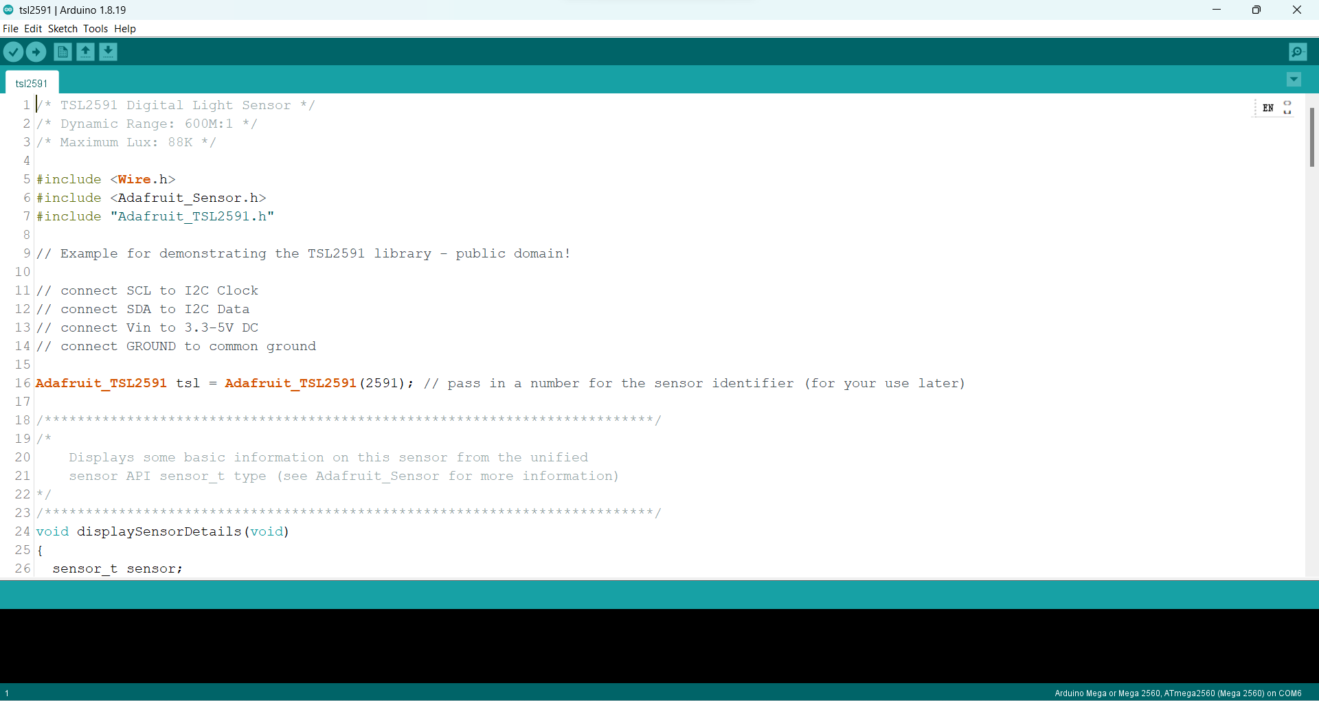
Read the code

Slide 36
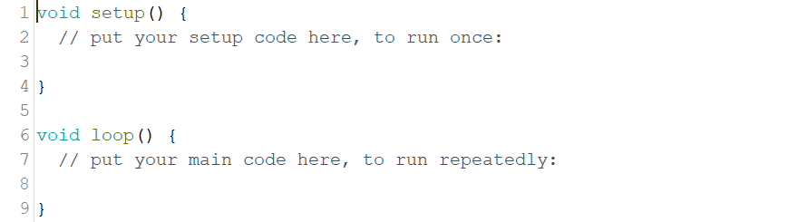
Write your own code
Download to the board

